Slide 1



AI Market Analysis Agent
Tech stack logos (FastAPI, LangGraph, Gemini, Streamlit, FAISS)

Slide 2
Project Objective
Tools & Technologies
Architecture
Agents & Workflow
Working Demo
What’s Next?

Slide 3
Problem Statement
Organizations struggle to analyze competitor moves and internal data quickly for market intelligence.
Need for faster, AI-assisted market research
Manual SWOT analysis is time-consuming

Slide 4
Solution Overview
AI chatbot-based Market Analyst
Uses LangGraph agents for reasoning
Combines internal docs + live web search (Tavily)
Generates insights and SWOT reports

Slide 5
Tech Stack
Category | Tool Used
LLM | Gemini 2.0 Flash via API
Agent Framework | LangGraph
Vector DB | FAISS
Backend API | FastAPI
Frontend | Streamlit
Embeddings | Google Generative AI Embeddings
Search | Tavily API

Slide 6
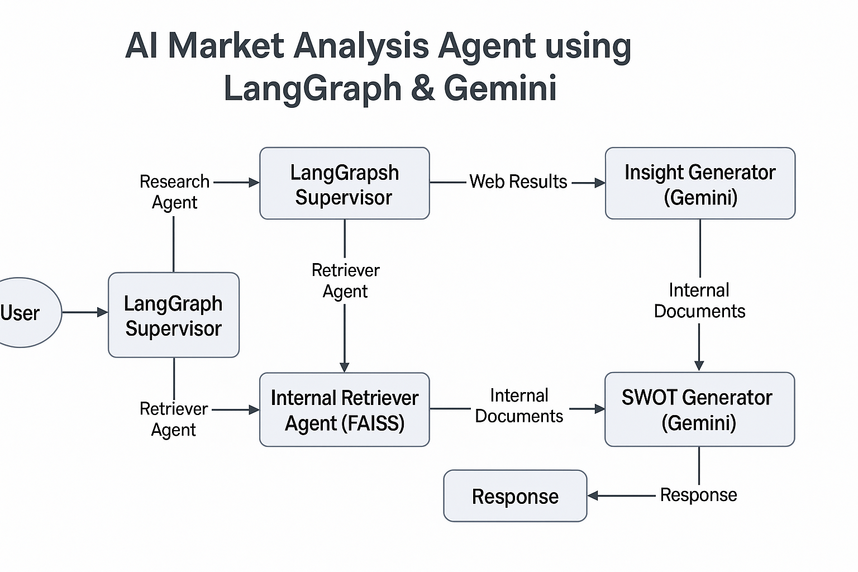
Architecture Diagram

Slide 7
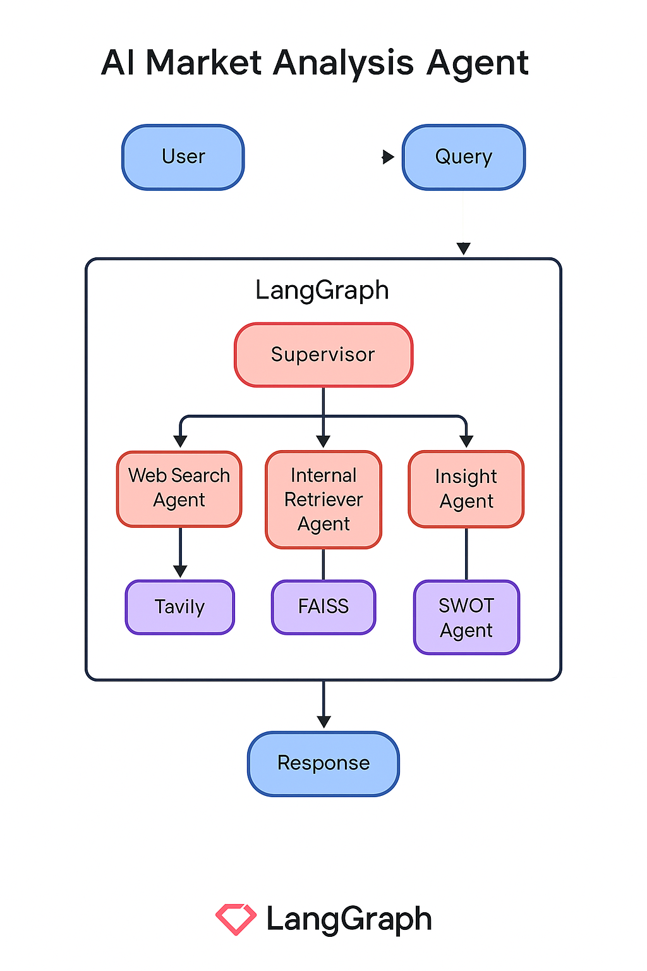
LangGraph Agent Workflow

Slide 8
Key Features
✅ Real-time web results + private internal docs
✅ Auto-generated SWOT reports
✅ Modular agent workflow (LangGraph)
✅ Scalable and pluggable

Slide 9
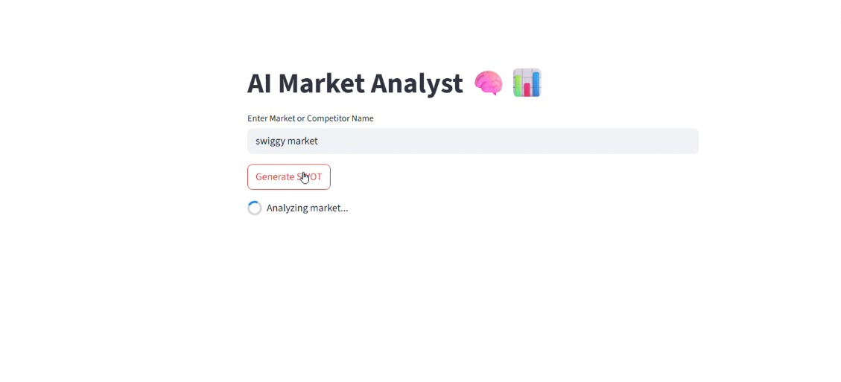
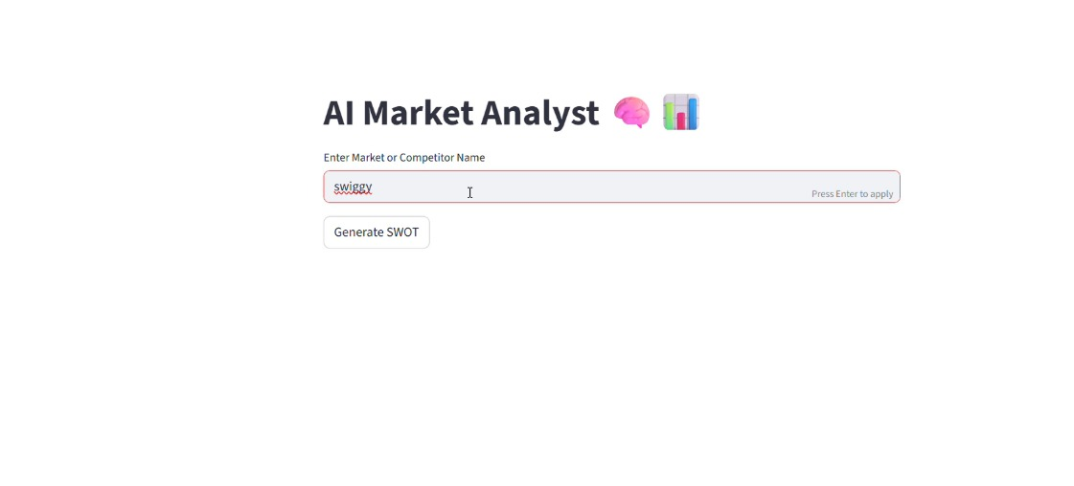
Working demo

Slide 10
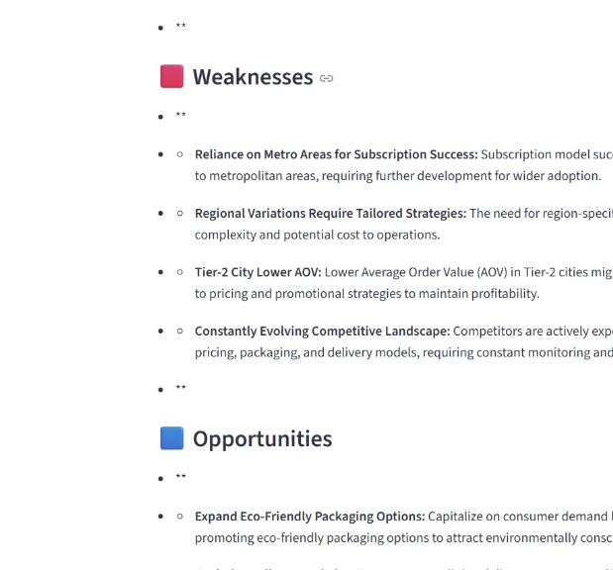
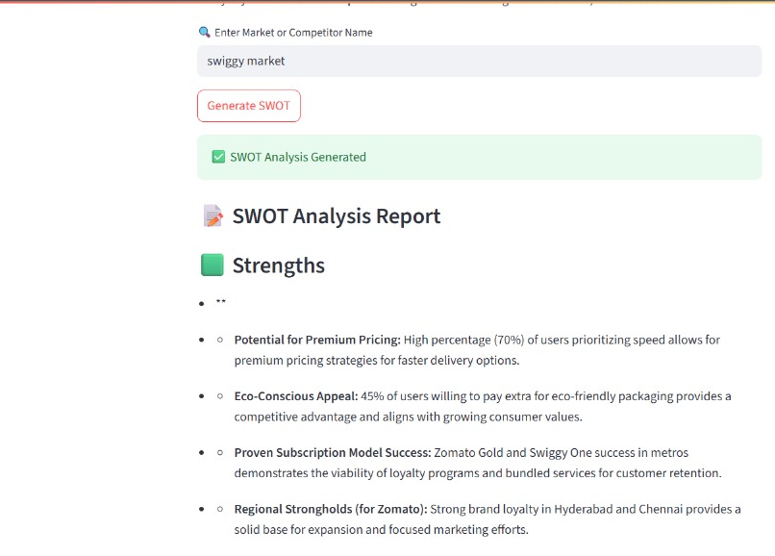
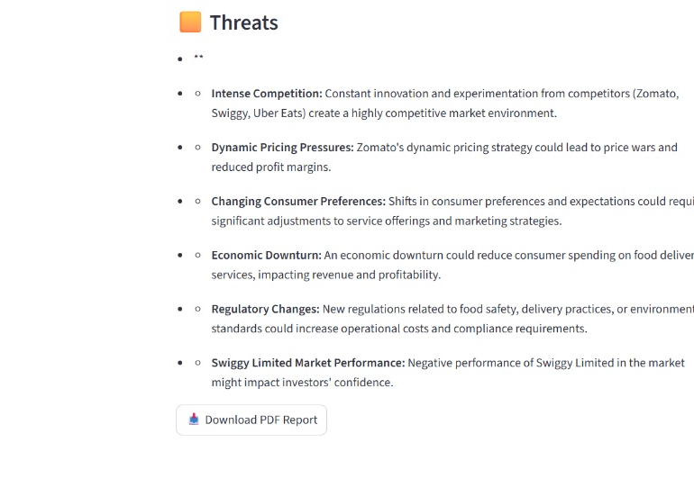

Slide 11
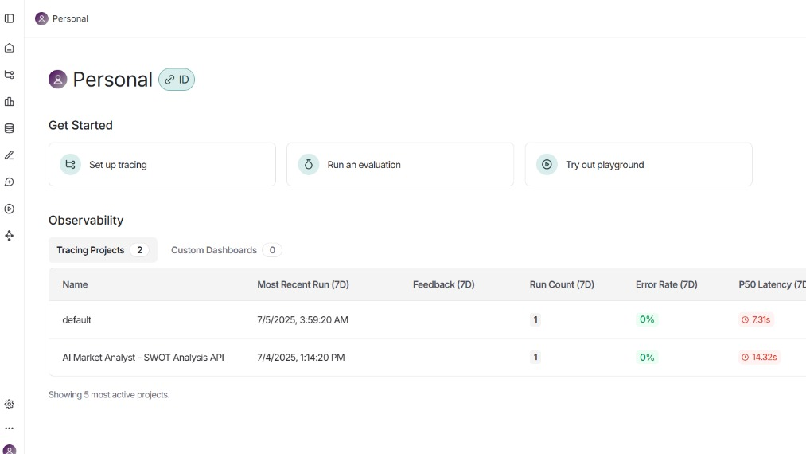

Slide 12
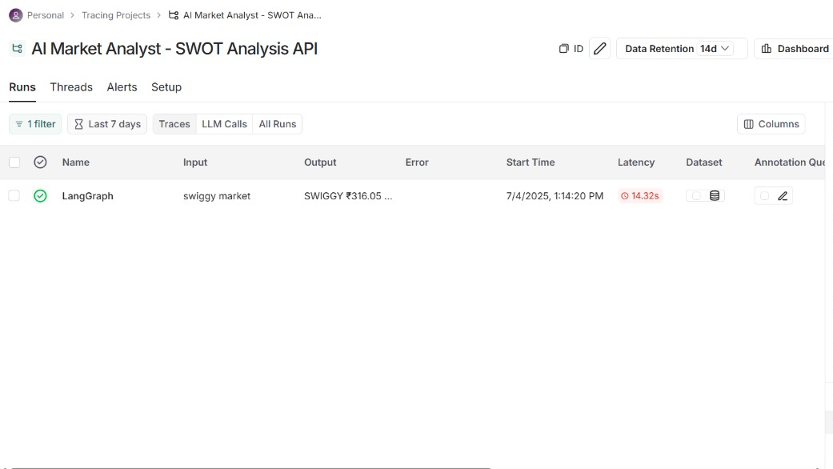

Slide 13
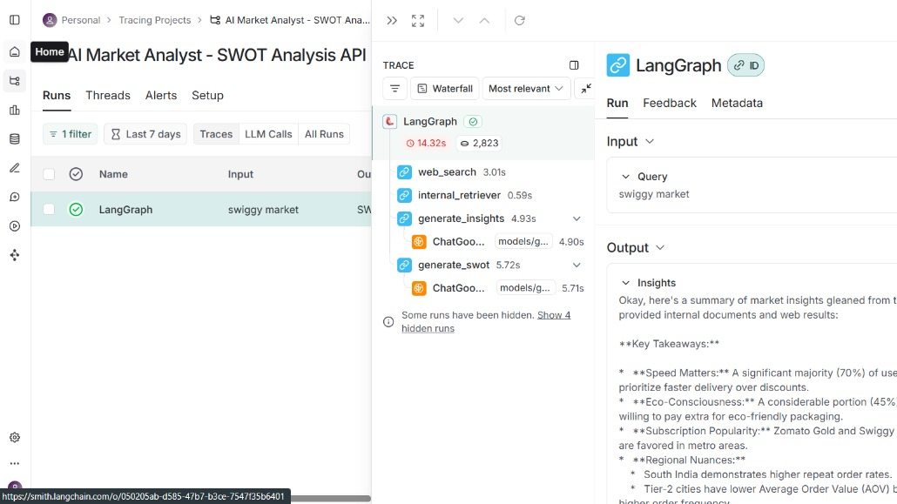

Slide 14
Takeaways
Gemini 2.0 Flash is fast and cost-effective
LangGraph simplifies agent workflows
Vector databases are essential for RAG
Agentic AI is the future of enterprise tools

Slide 15

Thank You

